Slide 1
Automating Builds in Git on IBM i
Sanjula Ganepola, IBM
Software Developer
sanjula.ganepola@ibm.com

Slide 2
Agenda
The Modern Development Lifecycle with Git
Unlock Automated Builds with ibmi-ci
ILE Dependency Analysis with Source Orbit
Practical Use Case
Demo

Slide 3
The Modern Development Lifecycle with Git

Slide 4
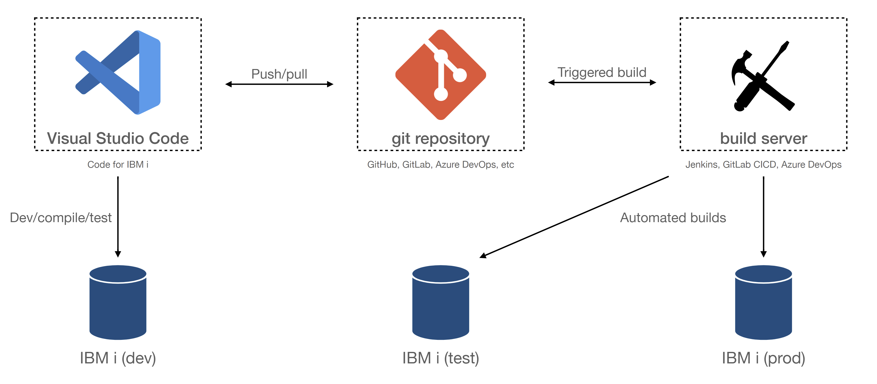
What Does Modern Development Look Like?

Slide 5
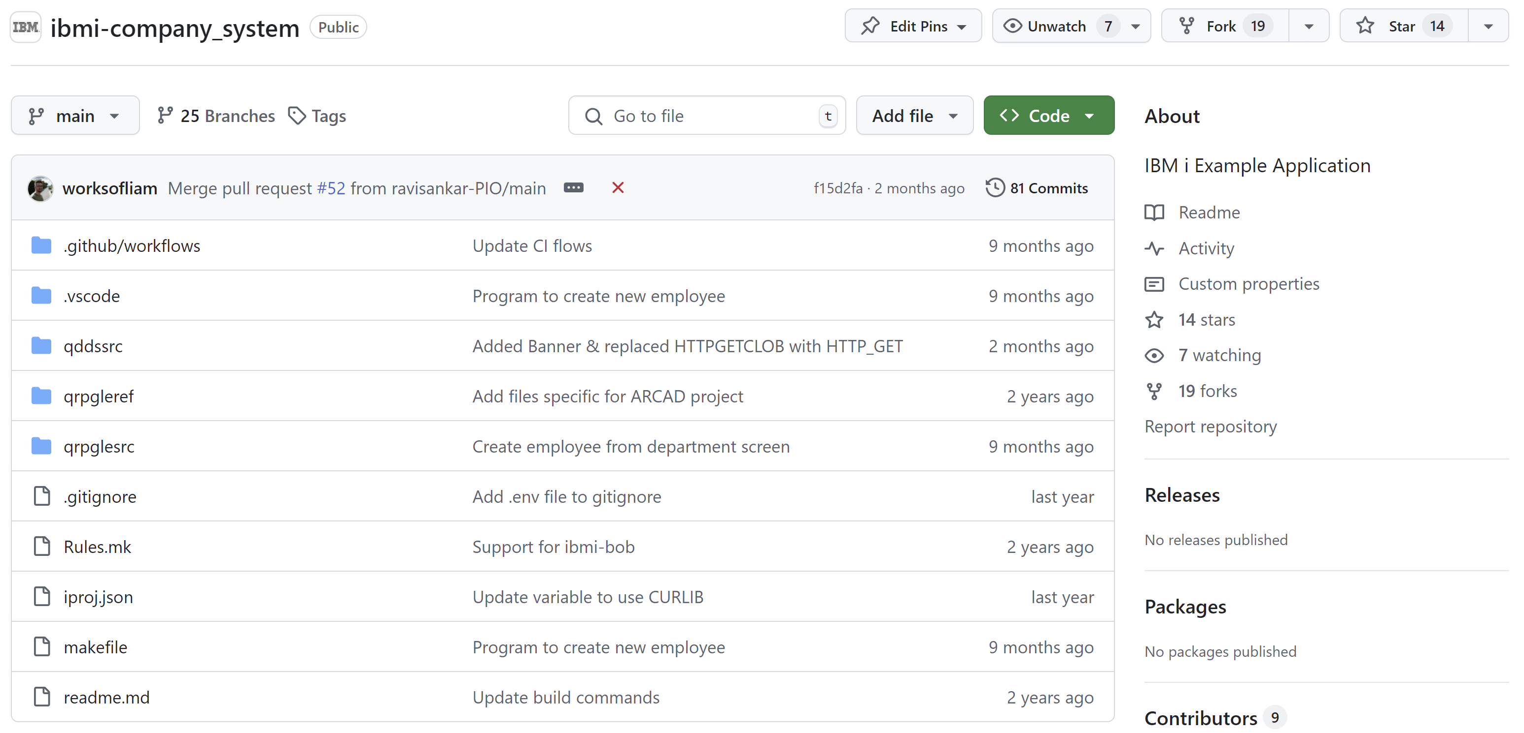

Development with Git
Source is managed by Git
Complete change history
Branching and merging capabilities
Traceability
Variety of options for Git hosting services
GitHub, GitLab, Azure DevOps, etc

Slide 6






Why use Git?
Distributed Development
Version Control and Git Workflow
master
Remote Git Repo (GitHub, GitLab, Azure, BitBucket, etc.)
release
feature/new-input
bug/broken-logic
Developer A
Developer B

Slide 7
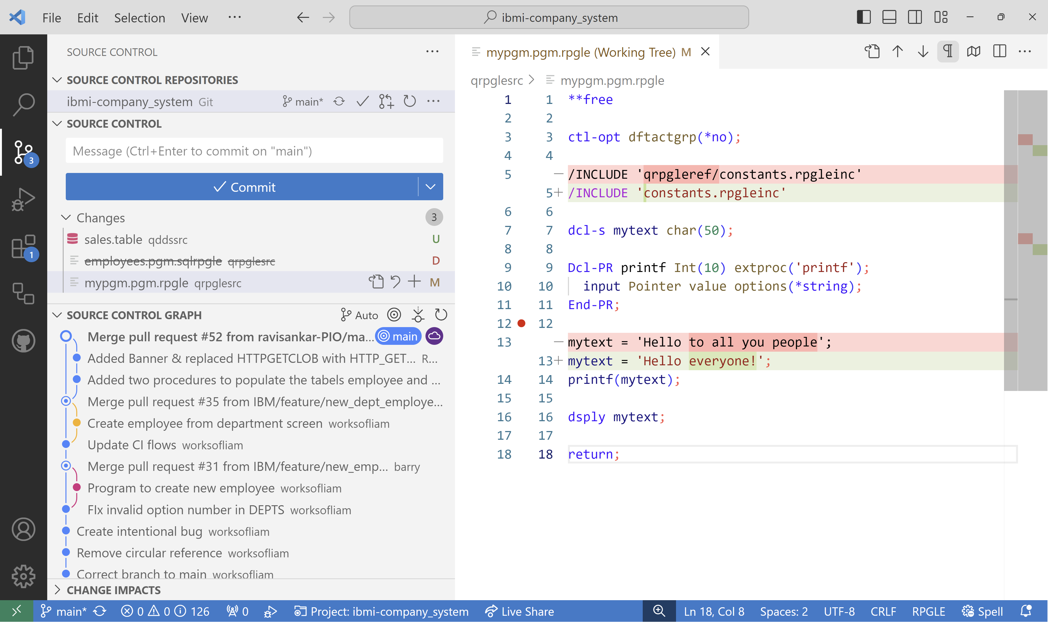
Local Development Experience
IBM i
IBM i integration via open-source extensions
Support for RPGLE, COBOL, CL, SQL, and more!
Git
First class Git support
Hundreds of Git tools
View current repository changes
View changes line by line
View a graphical representation of incoming and outgoing commits

Slide 8
How to work efficiently with these 3 components?

Slide 9
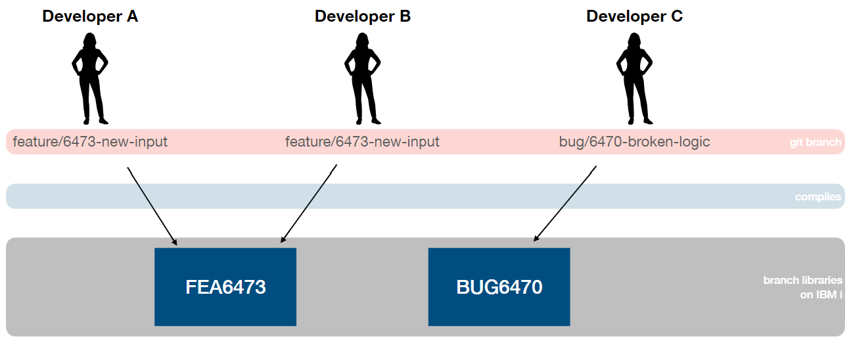
Map Git branches to libraries on IBM i

Slide 10
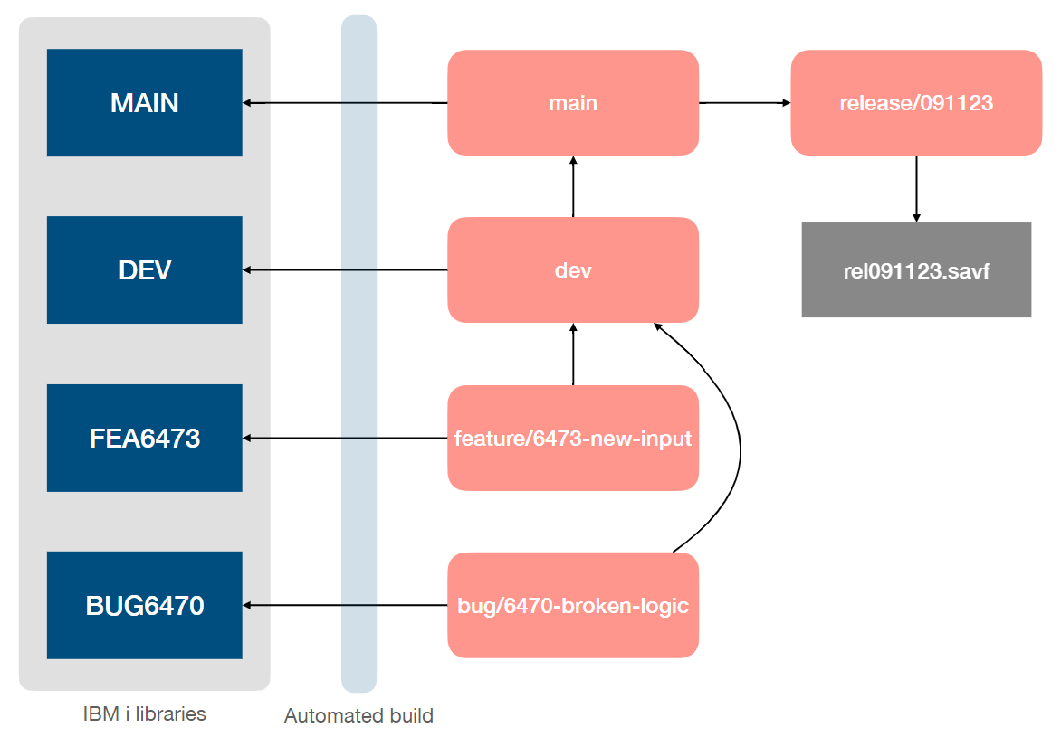
Build Server
Let’s go one step further and automate this process
Generate save files when releases are created
Automate build into branch library when Git branch is updated

Slide 11
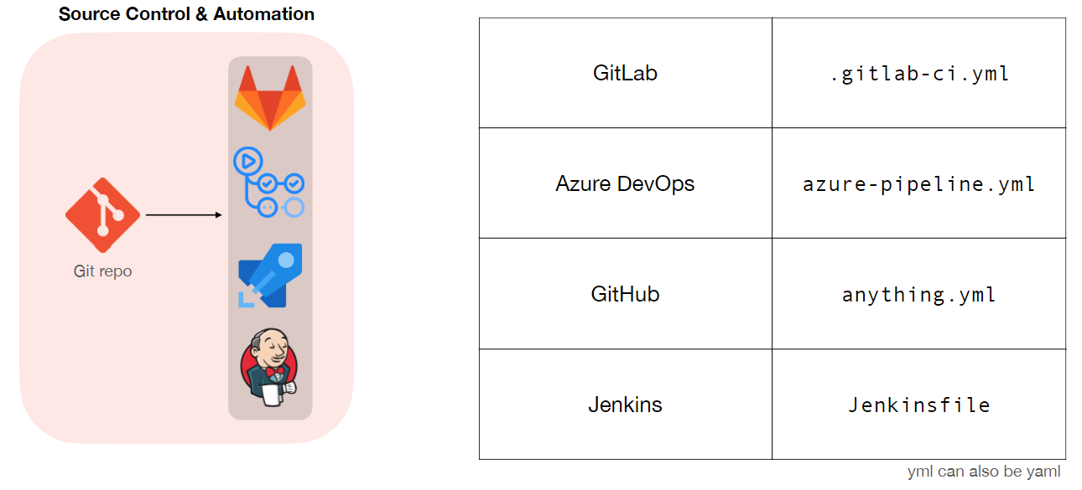
How to create workflows?

Slide 12
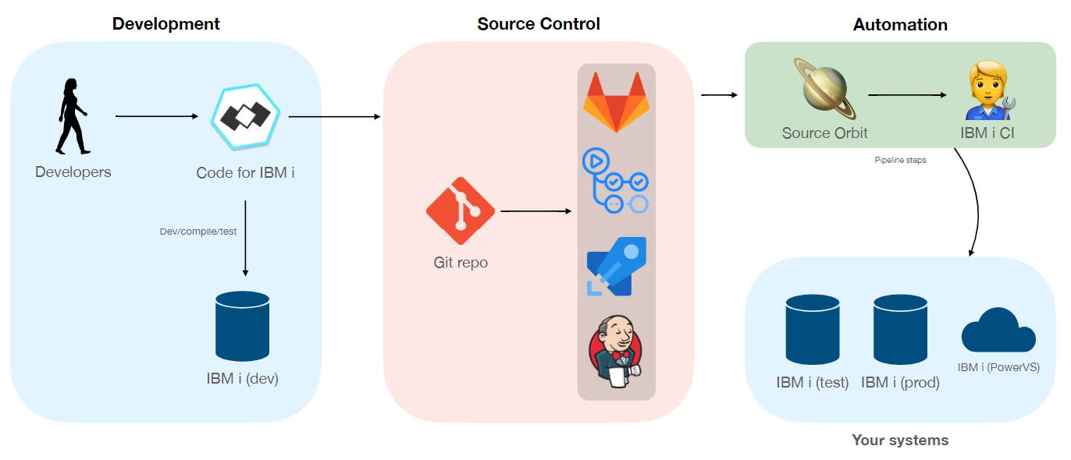
How to achieve automation with IBM i?

Slide 13
Unlock Automated Builds with ibmi-ci

Slide 14
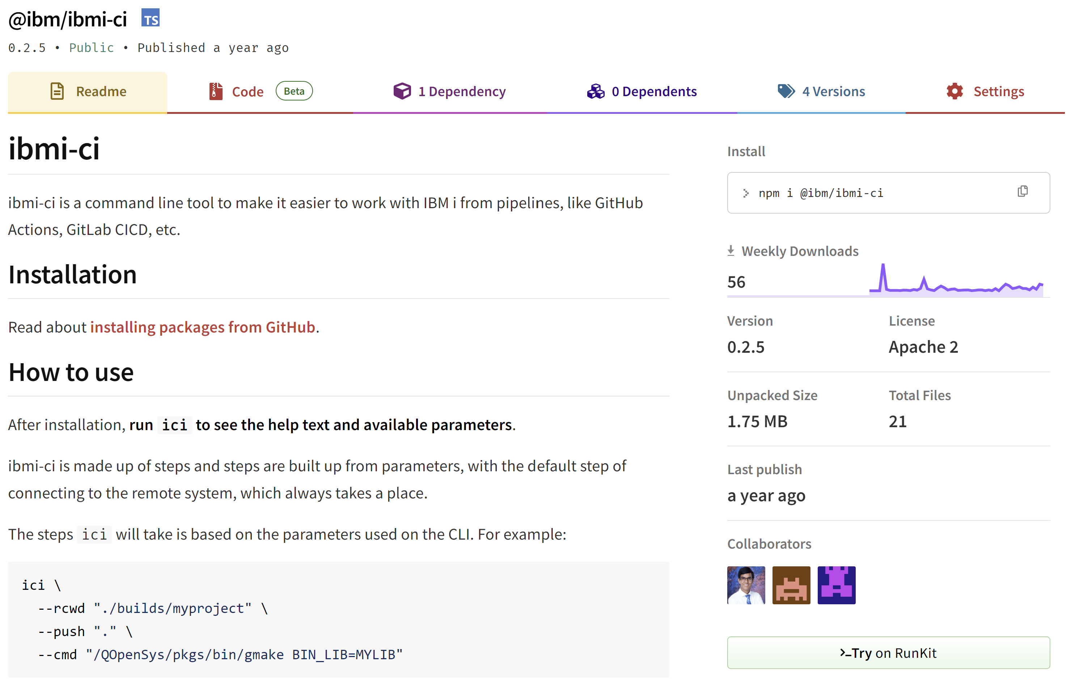
Overview
A CLI tool to simplify working with IBM i from pipelines (ex. GitHub Actions, GitLab CICD, etc.)
Outline a series of steps to perform with the first default step being to connect to an IBM i
Requirements
SSH server is running on IBM i
Node.js needs to be installed
Installation
npm i -g @ibm/ibmi-ci
Establishing IBM i connection
Required
IBMI_HOST
IBMI_USER
IBMI_SSH_POST
At least one required
IBMI_PASSWORD
IBMI_PRIVATE_KEY

Slide 15
CLI Usage
--lcwd <localDirectory>
--rcwd <remoteDirectory>
--push <remoteRelativeDirectory>
--pull <remoteRelativeDirectory>
--get <remoteRelativeDirectory> <localRelativePath>
--cmd <shellCommand>
--cl <clCommand>
Sets the current working directory on the local system
Sets the current working directory on the remote system. It will be created if it does not exist.
Pushes the current working directory to a chosen directory on the IBM i
Pulls a directory from IBM i to the local current working directory
Gets a specific file from IBM i
Execute a command on the remote system
Execute a CL command on the remote system

Slide 16
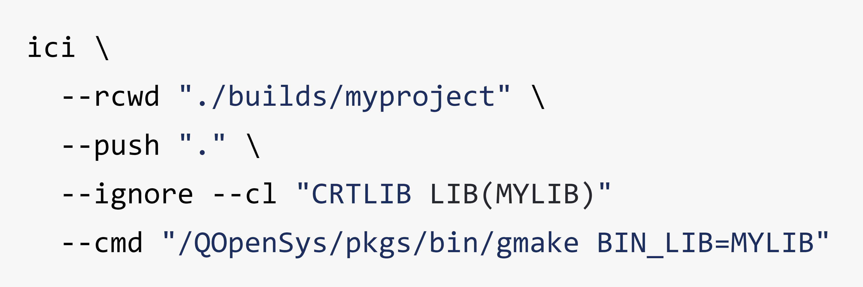
Simplistic Example
Set the remote working directory to ./builds/myproject
Upload the local working directory to the remote working directory (.)
Create build library if it does not exist
Build project with gmake
⭐IBM i connection is specified as environment variables
Suppress errors and continue execution

Slide 17
GitHub Action Example
jobs:
ibmi-build:
environment: COMMON1
runs-on: ubuntu-latest
steps:
# Checkout repository and setup node steps omitted
- name: Install Dependencies
run: npm i -g @ibm/ibmi-ci
- name: Deploy to IBM i
run: |
ici \
--cmd "mkdir -p './builds/ics_${GITHUB_HEAD_REF}'" \
--rcwd "./builds/ics_${GITHUB_HEAD_REF}" \
--push "." \
--cmd "/QOpenSys/pkgs/bin/gmake BIN_LIB=CMPSYS"
env:
IBMI_HOST: ${{ secrets.IBMI_HOST }}
IBMI_USER: ${{ secrets.IBMI_USER }}
IBMI_PASSWORD: ${{ secrets.IBMI_PASSWORD }}
IBMI_SSH_PORT: ${{ secrets.IBMI_SSH_PORT }}
GITHUB_HEAD_REF is the head ref or source branch of the pull request
IBM i connection is specified as environment variables

Slide 18
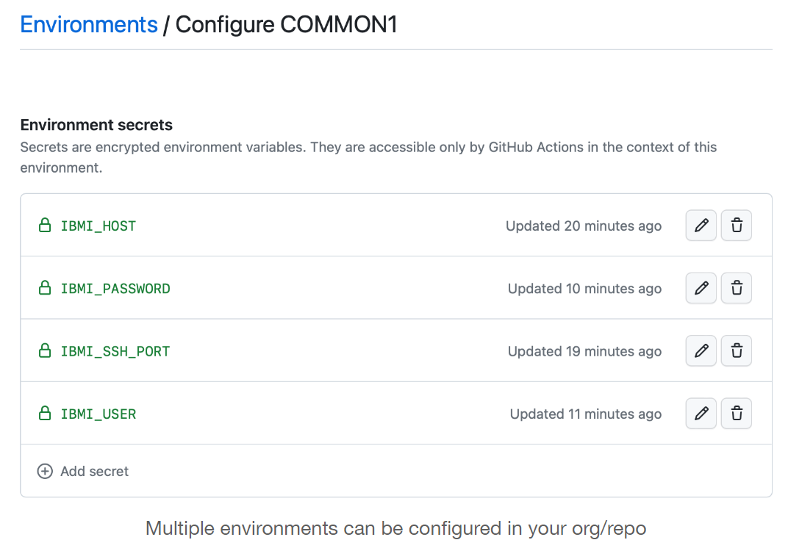
Why use environments?
Use a matrix to run a workflow on multiple IBM i machines
jobs:
ibmi-build:
strategy:
matrix:
environment: [COMMON1, OSSBUILD]
environment: ${{ matrix.environment }}
runs-on: ubuntu-latest

Slide 19





How do GitHub Actions work?
GitHub
👨🏻‍💻 Developer
🖥️
Runner
Develop app
Push source
Trigger event
Run workflow
Run build
Visual Studio Code
Git Repository
GitHub Actions
IBM i
Events are what trigger workflows to run
Machine that execute workflows (@ibm/ibmi-ci installed here)

Slide 20
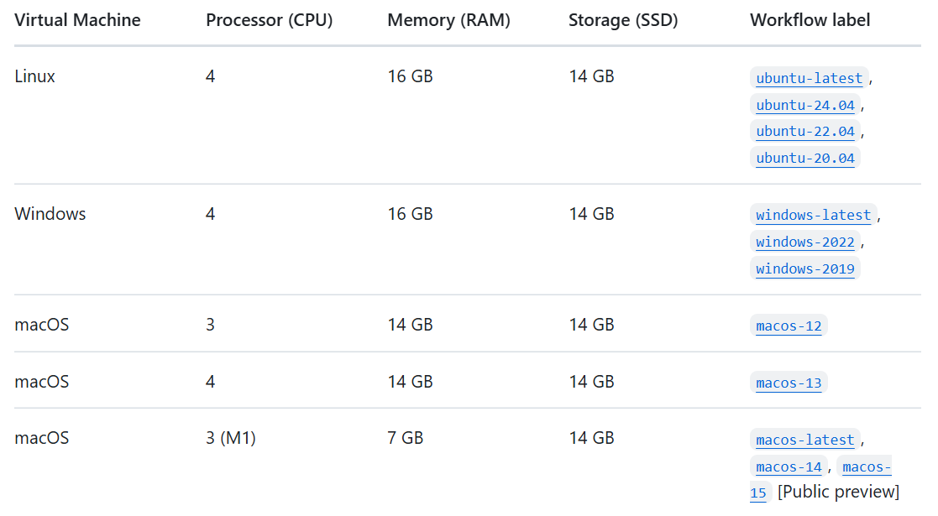
What are Events and Runners?
Events
↓
Workflow triggers that cause a workflow to run
Runners
↓
Machines that execute jobs in a workflow
on:
push:
branches: [ main ]
pull_request:
branches: [ main ]
types: [opened]
release:
types: [created]
workflow_dispatch:
-latest runner images are the latest stable images that GitHub provides, and might not be the most recent version of the operating system

Slide 21
ILE Dependency Analysis with Source Orbit

Slide 22
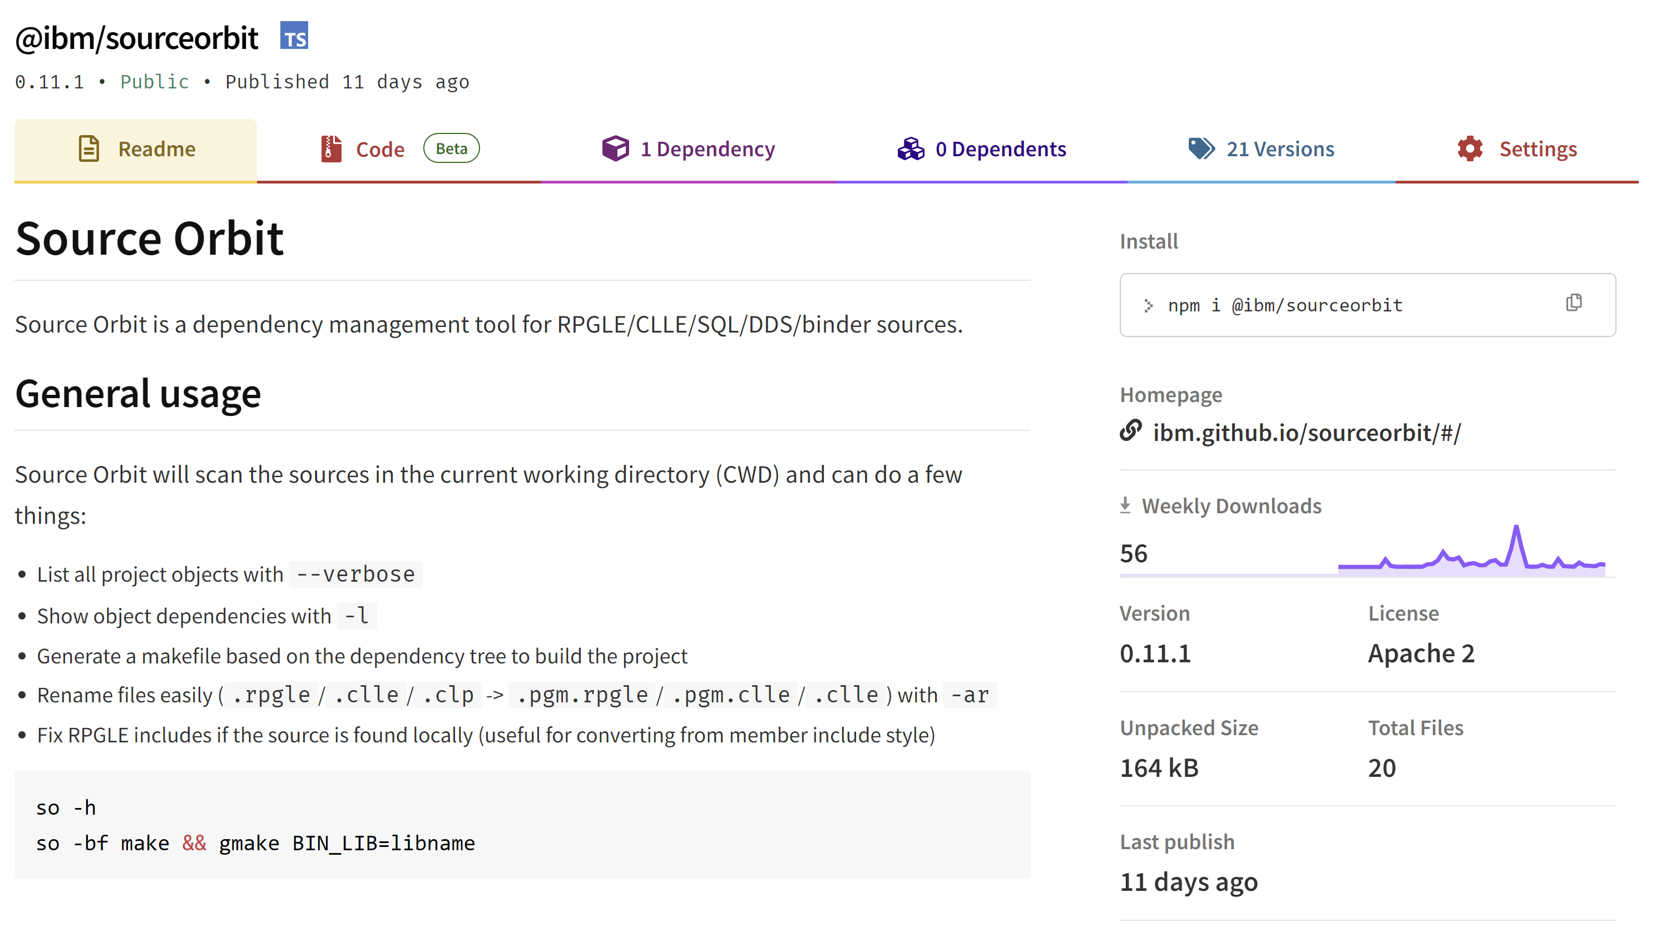
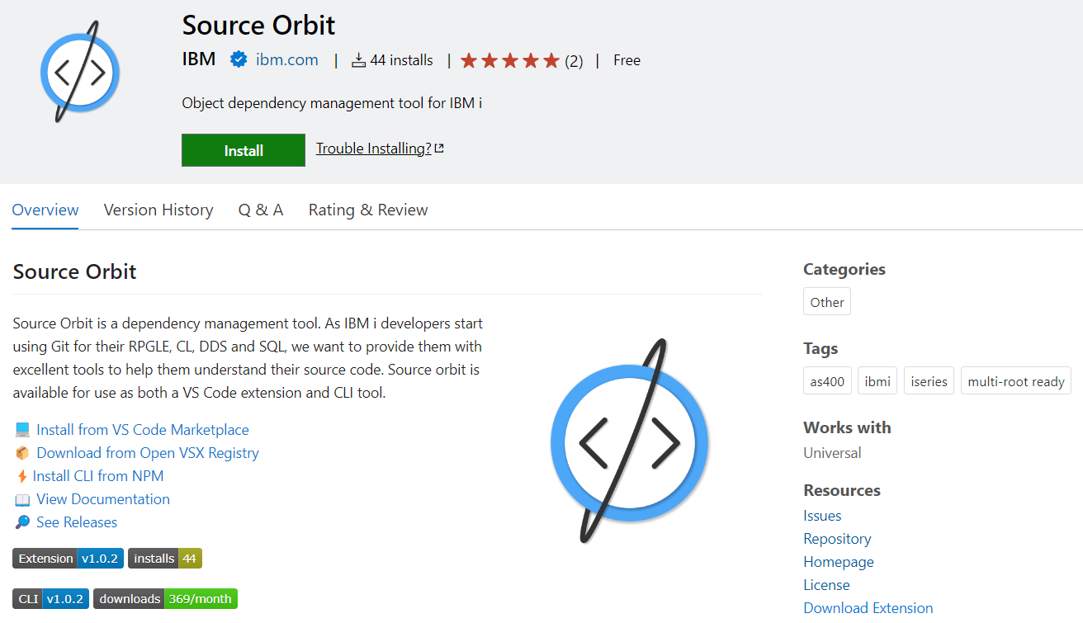
Overview
A dependency management tool (CLI and VS Code extension!)
Build dependency tree for RPGLE, DDS, SQL, CL, etc.
Generates impact analysis information
Generate scripts to automate builds
Clean up your project
Requirements
Node.js needs to be installed
CLI Installation
npm i -g @ibm/sourceorbit
Extension Installation
https://marketplace.visualstudio.com/items?itemName=IBM.vscode-sourceorbit

Slide 23
CLI Usage
so –ar
Scan all source code and fix extensions
Rename programs to have .pgm.
Rename include files to use .rpgleinc
Rename SQL source to use extension based on CREATE statement
so –fi
Fix include/directory directives to use UNIX style paths if found in local source
so -bf <type>
Generate build and dependency files
make: Generate single makefile with targets and rules
bob: Generate Rules.mk files for Bob
imd: Generate impact analysis for branches
json: Generate dependency info as JSON
so –bl <name>
Generate a deterministic library name given a branch name

Slide 24
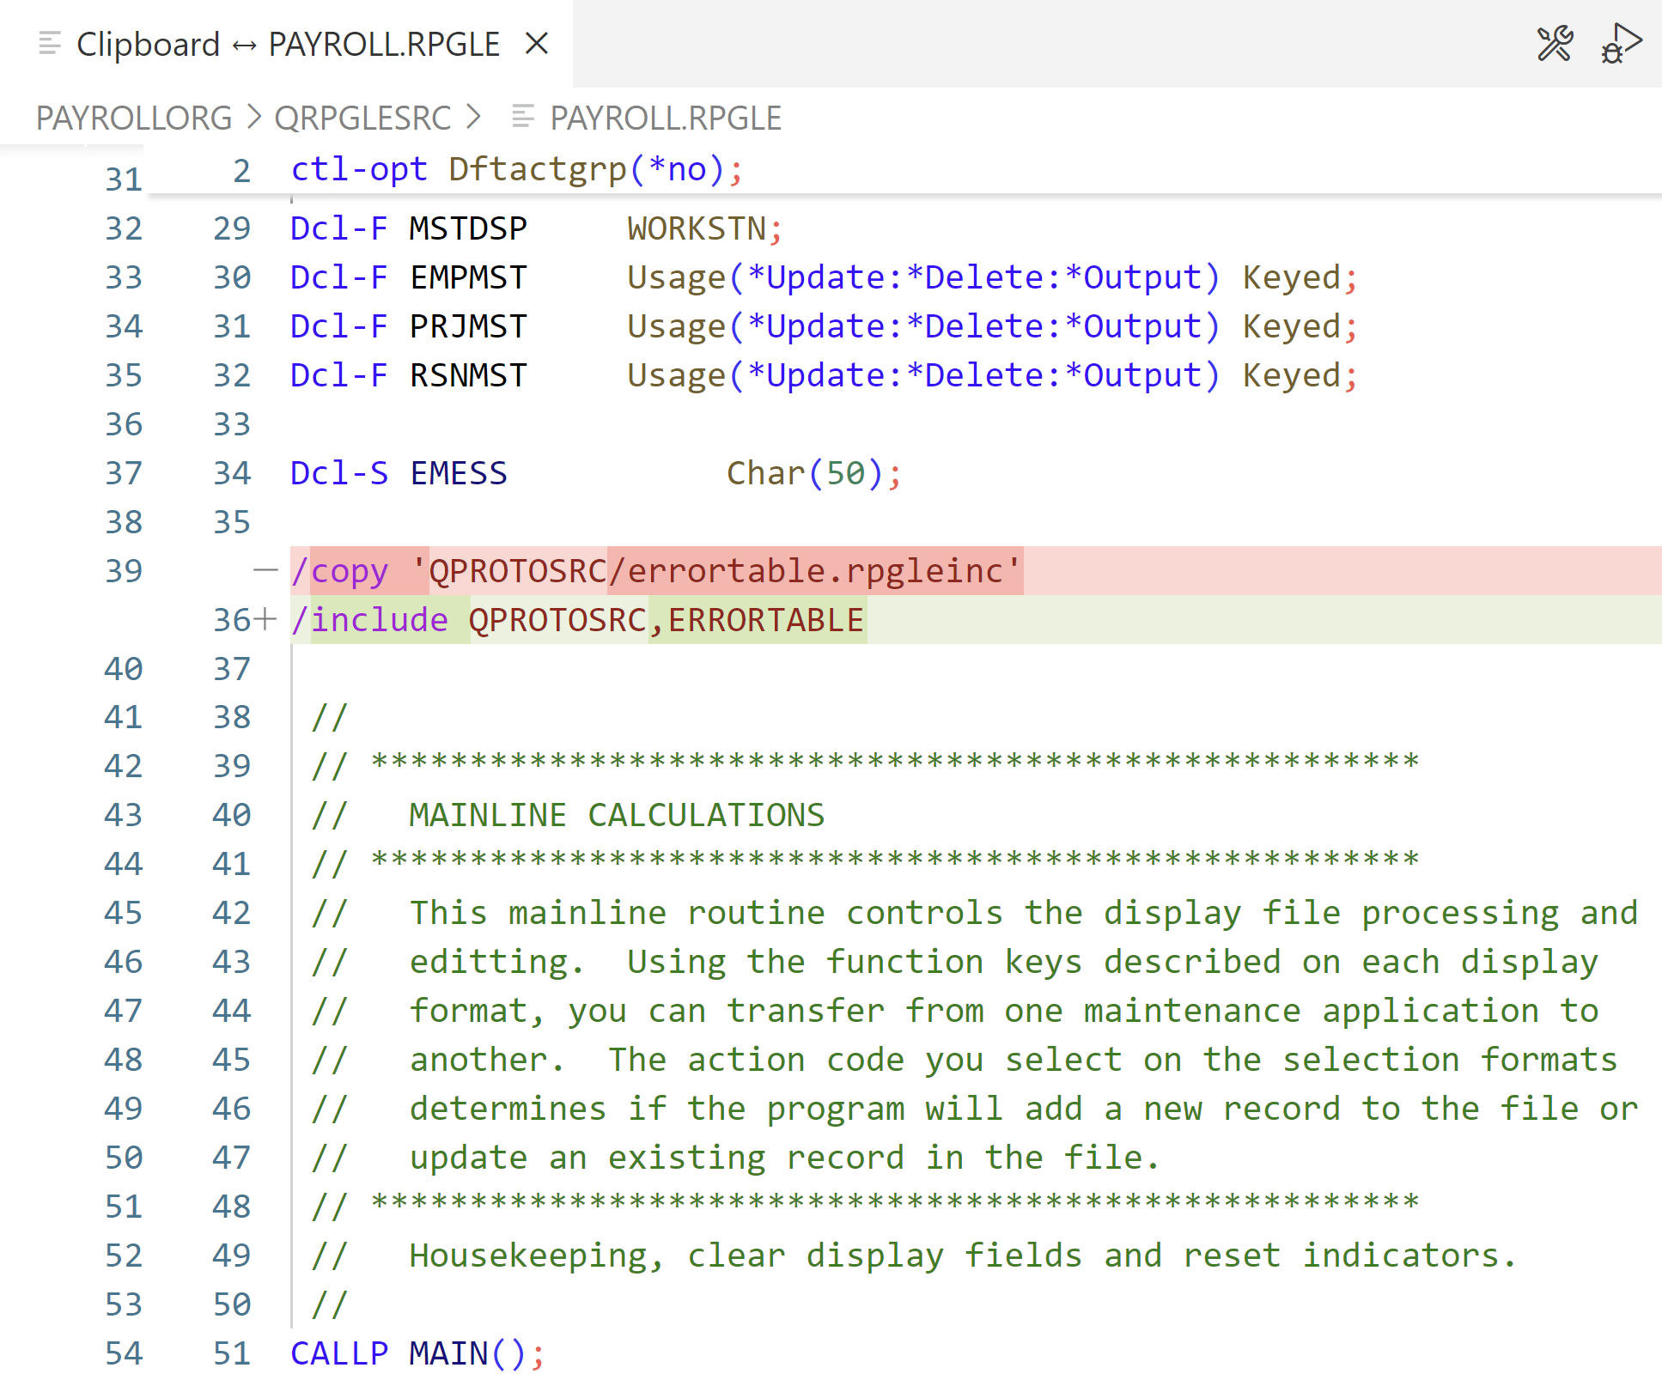
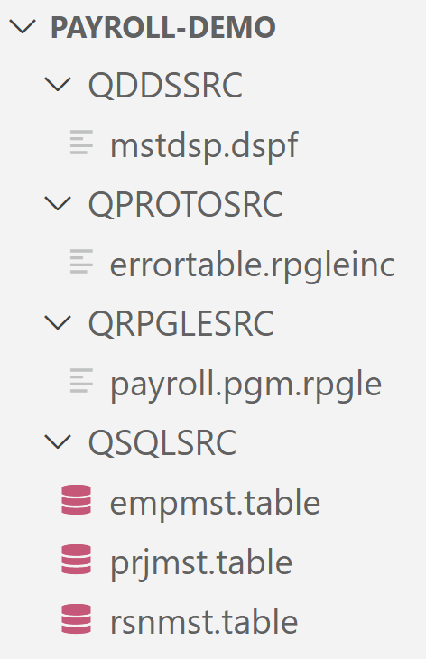
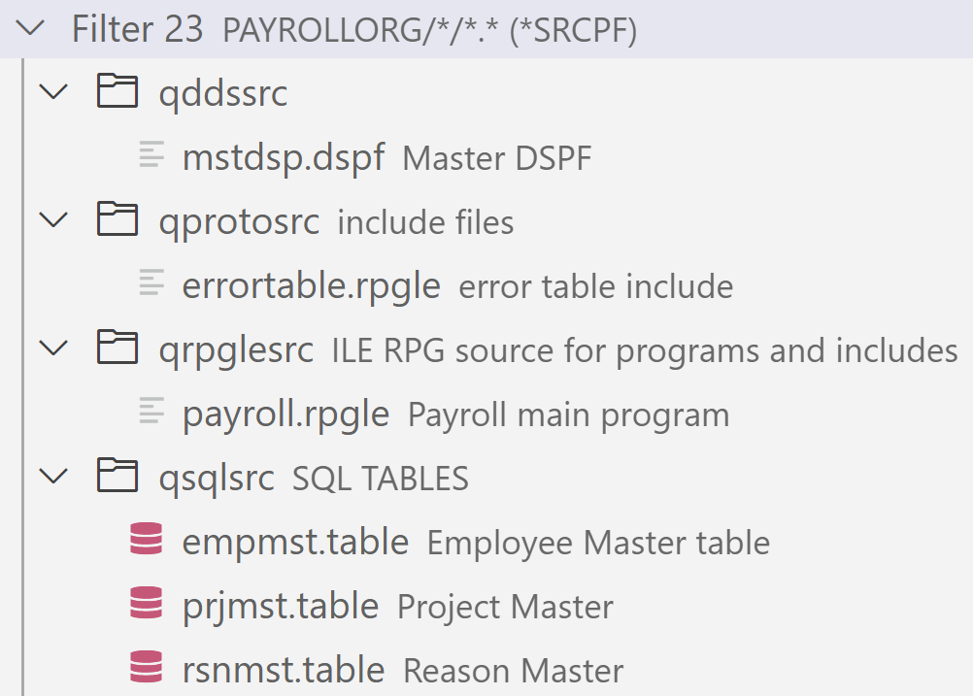
Repository Cleanup
Source Locally
Original source in QSYS
Cleaned up file extensions
Cleaned up source code

Slide 25
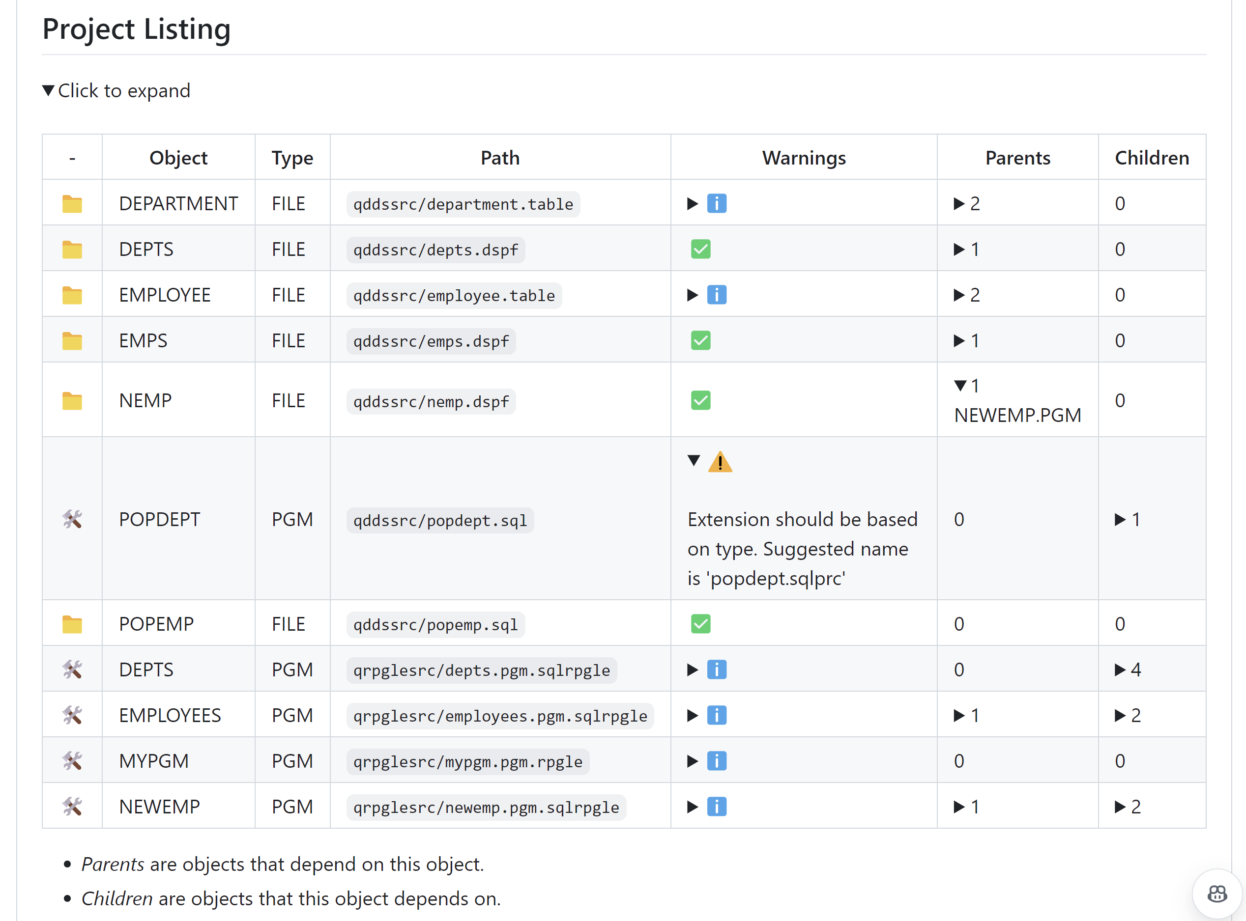
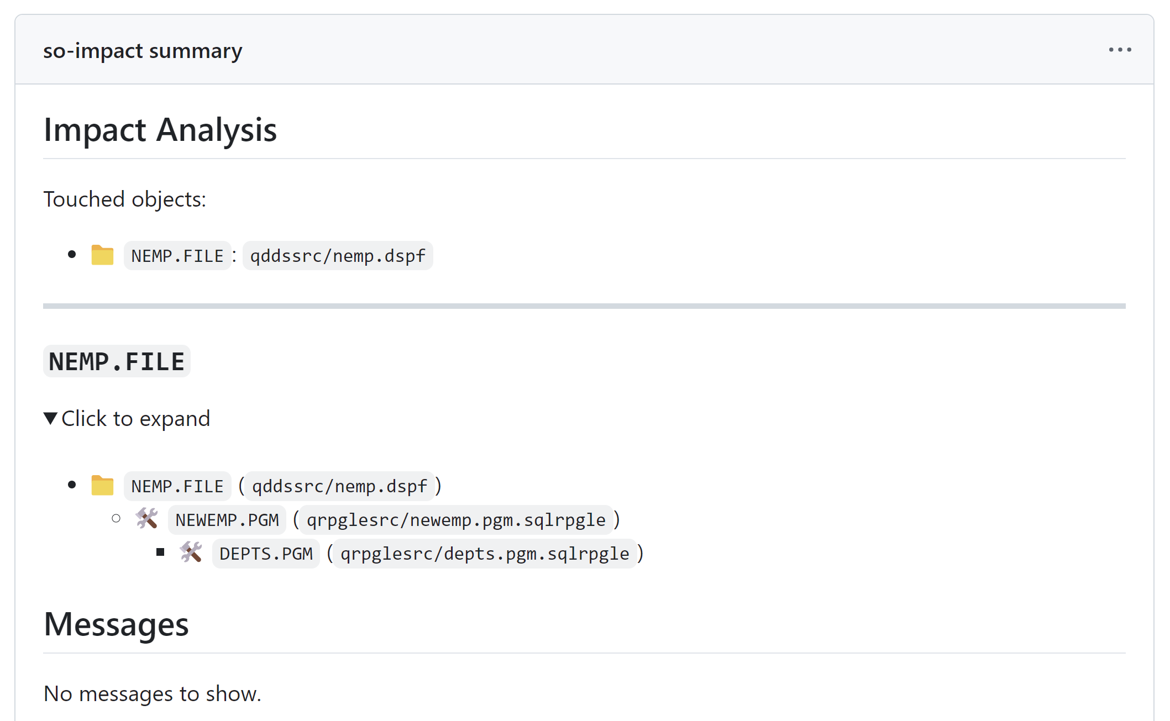
Impact Analysis…What Objects Am I Affecting?
Full project dependency tree
Impacted objects based on source changes
Dependencies of impacted objects

Slide 26
GitHub Action Example
jobs:
so-impact:
runs-on: ubuntu-latest
steps:
# Checkout repository and setup node steps omitted
- name: Install Dependencies
run: npm i -g @ibm/ibmi-ci
- name: Generate impact information
run: so -bf imd -l `git diff --name-only origin/main origin/${GITHUB_HEAD_REF}`
- name: Adding markdown
run: cat impact.md >> $GITHUB_STEP_SUMMARY
Generate impact analysis for changed files (compare main branch with pull request branch)
Redirect output to GITHUB_STEP_SUMMARY to create a custom Markdown job summary

Slide 27
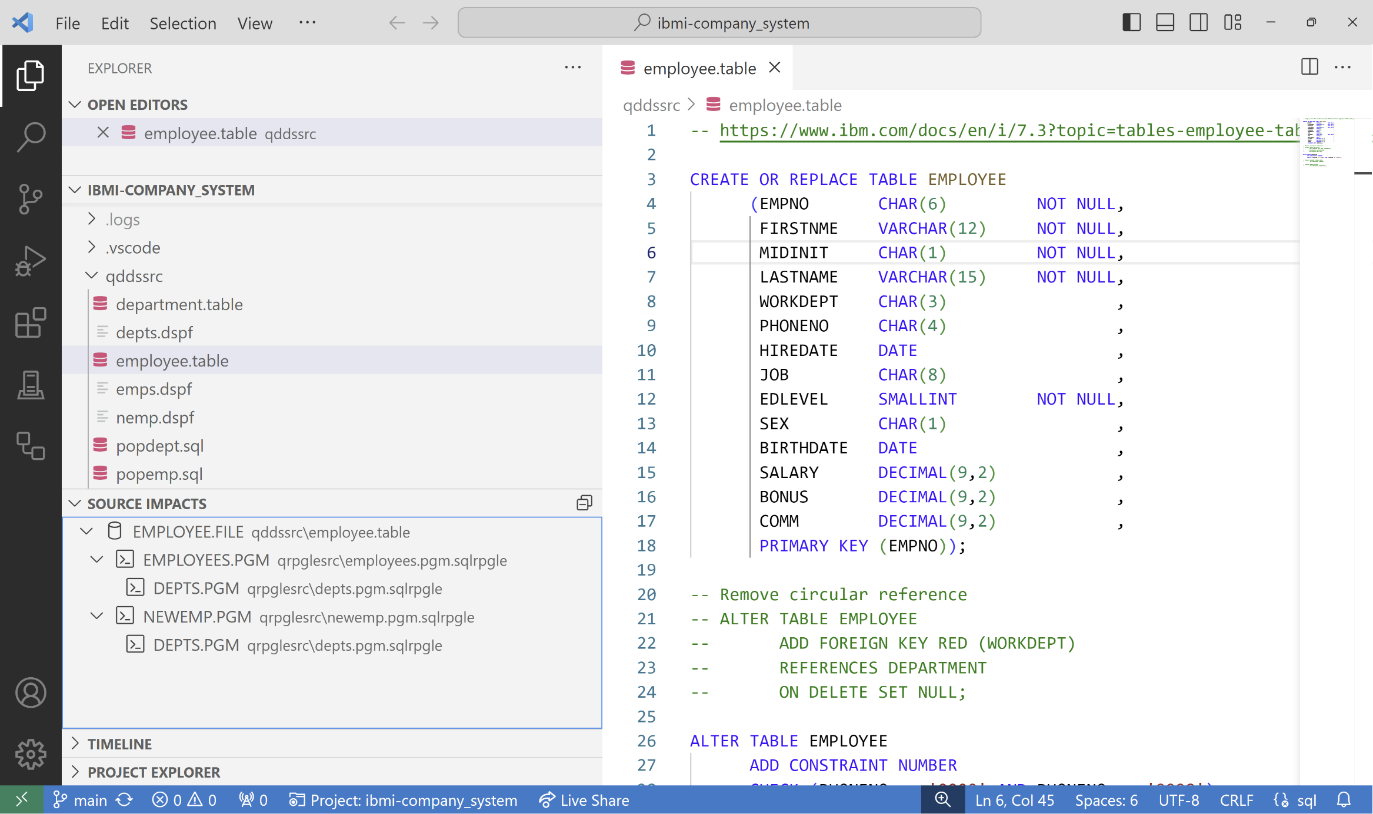
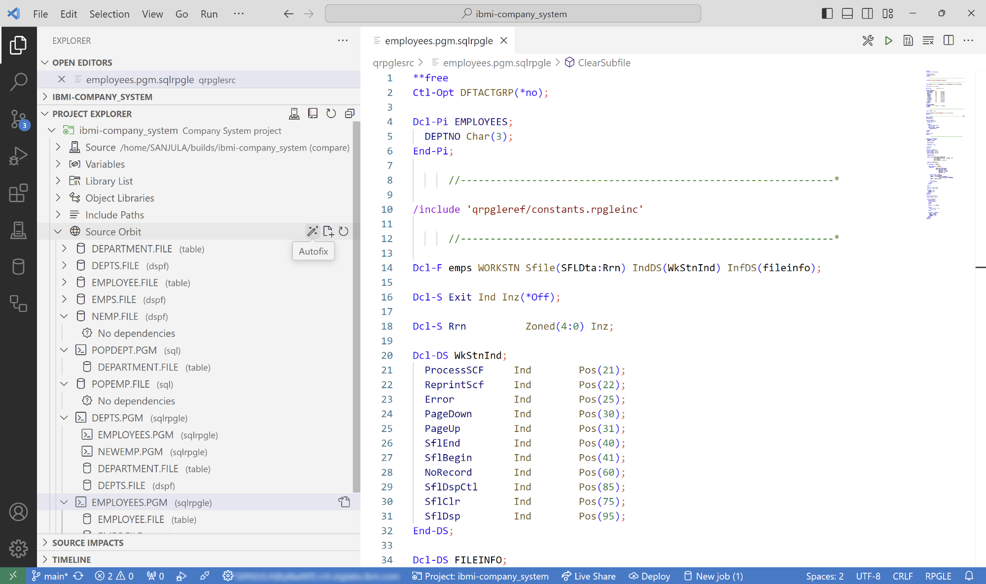
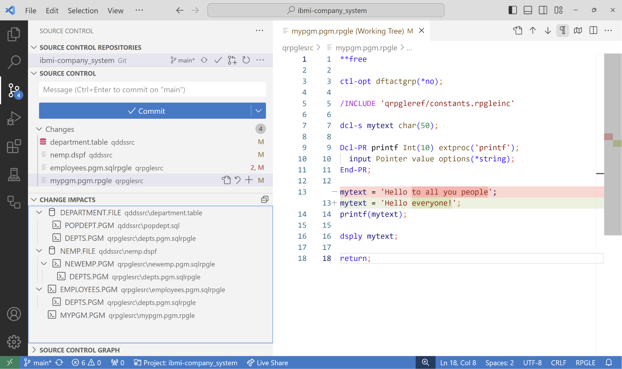
What is built into the Source Orbit VS Code extension?
View impacted objects for the current active editor
View project’s dependency tree with integration in IBM i Project Explorer
Actions to “Autofix” and “Generate Build Files”
View impacted objects for any changed files detected by Git

Slide 28
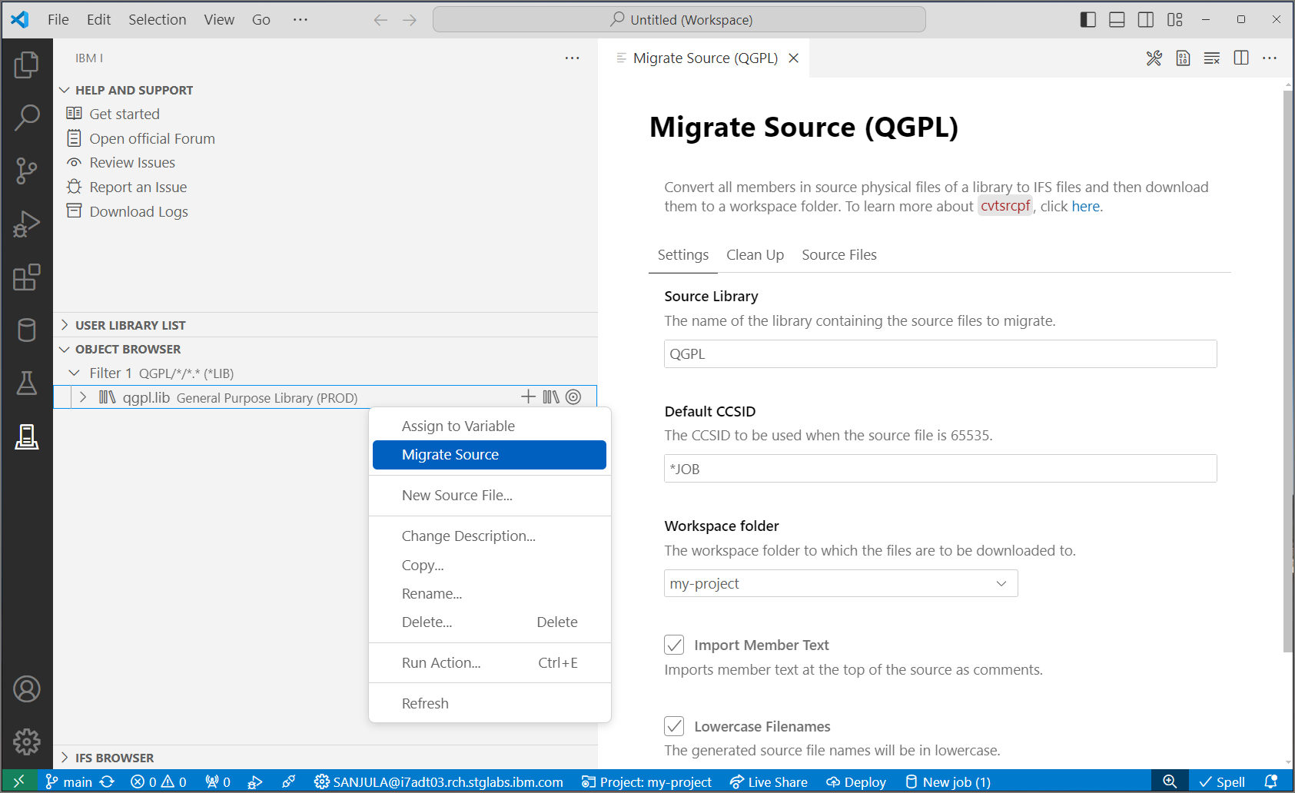


Source migration made easy
QSYS members in source physical files
↓
Properly encoded, terminated, and named source files in an IFS directory
↓
Download to local project
↓
Rename extensions
↓
Convert includes/copy directives to Unix style paths
CVTSRCPF from BOB
Source Orbit

Slide 29
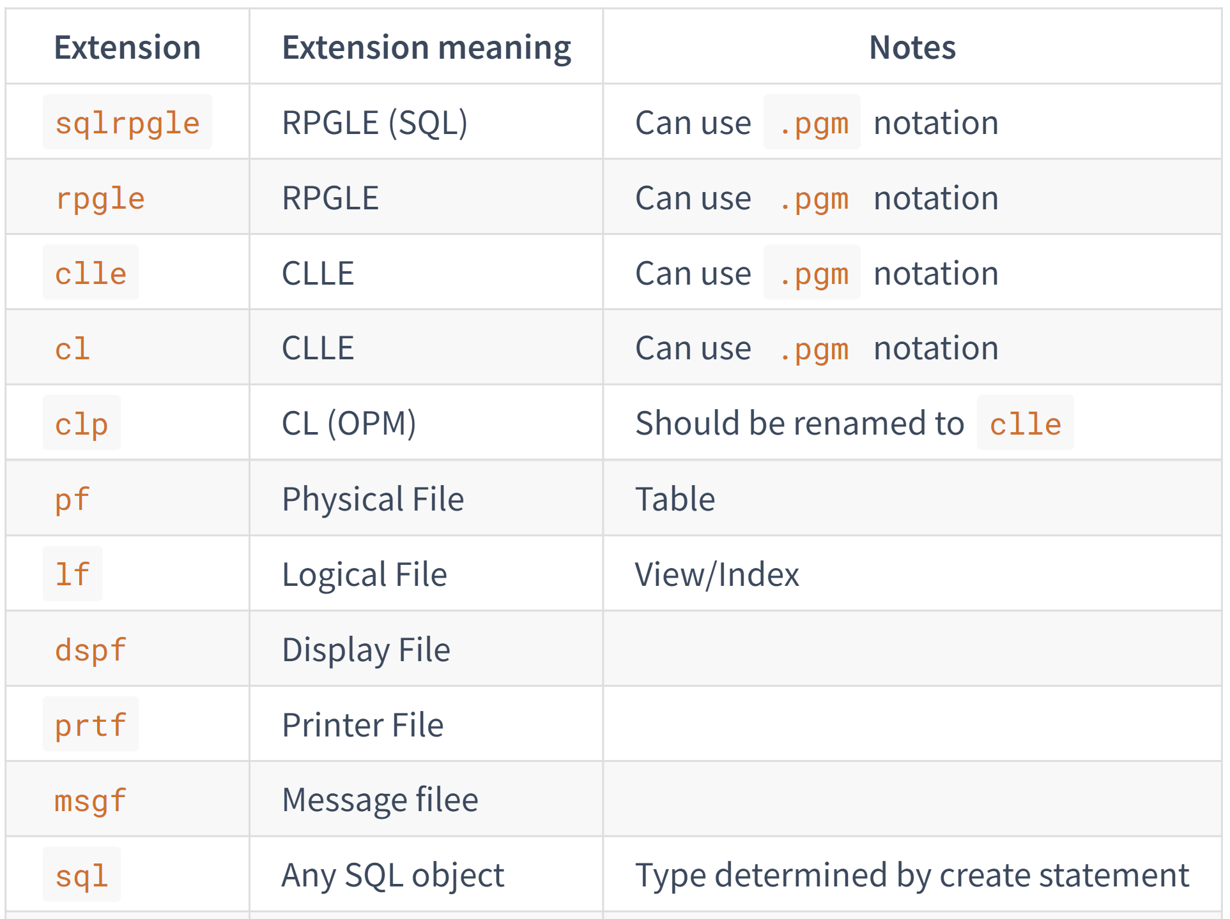
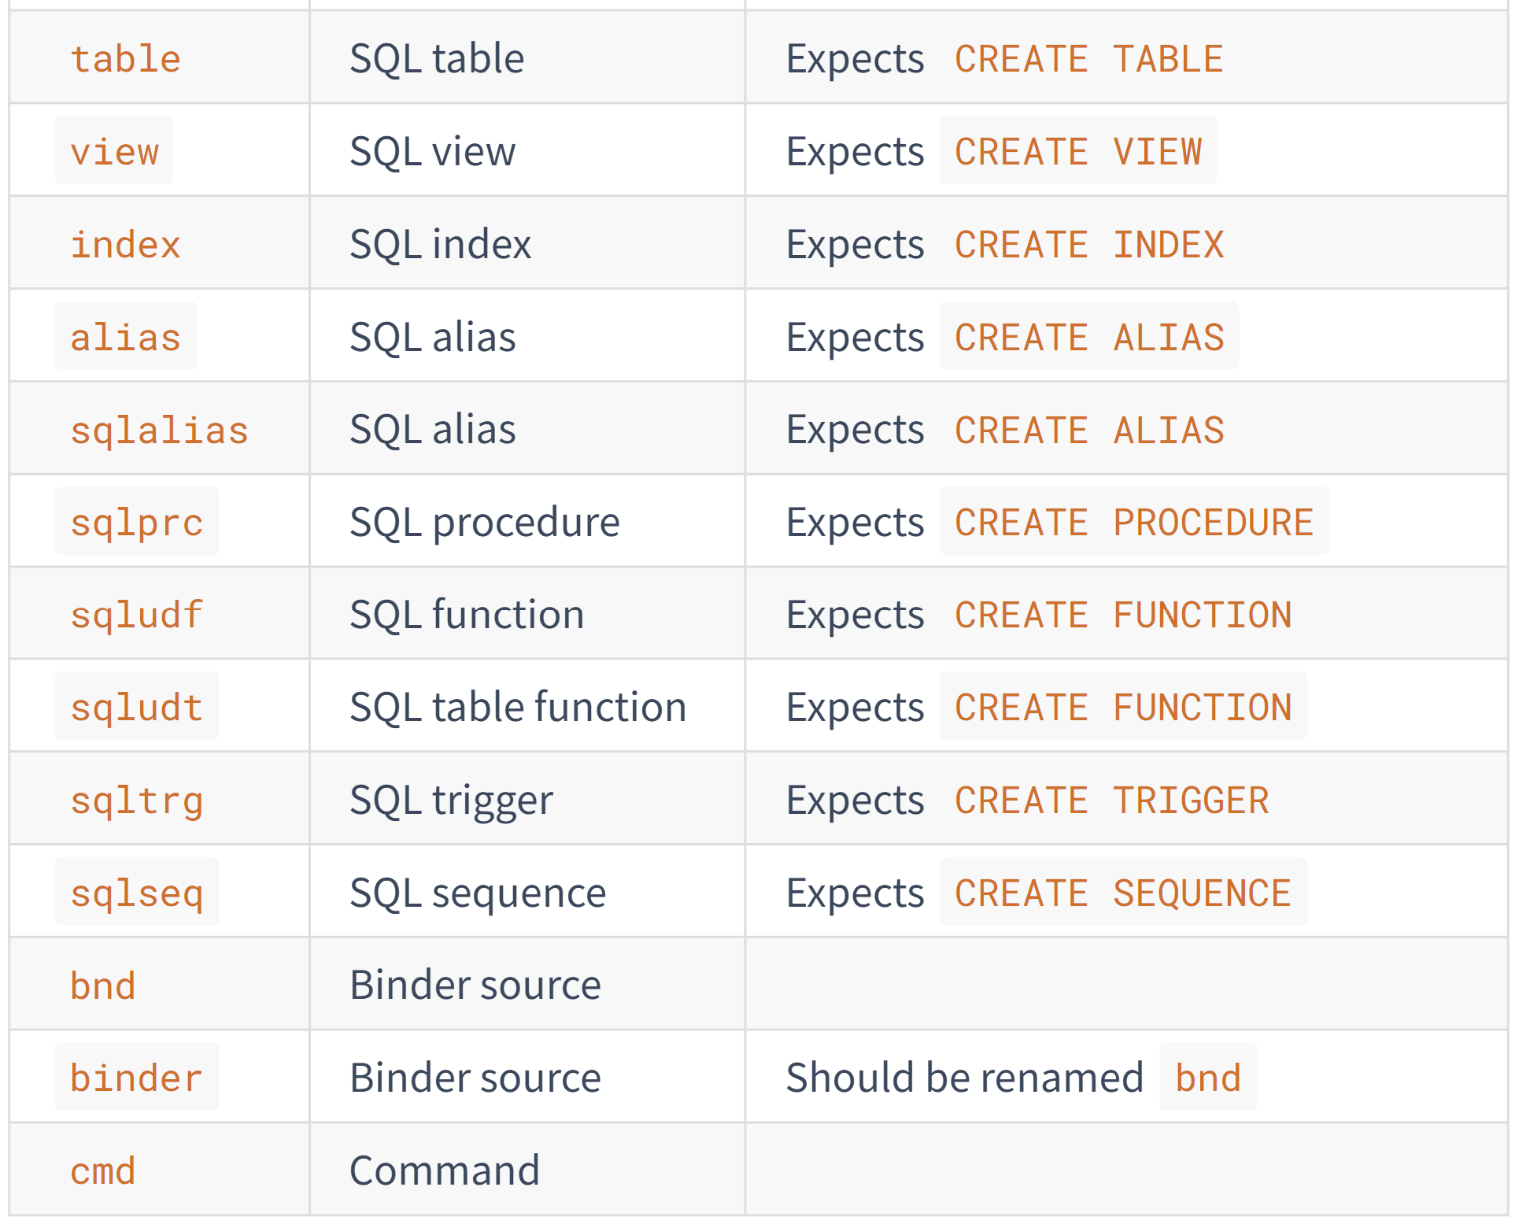
Source Code Rules – Supported Extensions

Slide 30
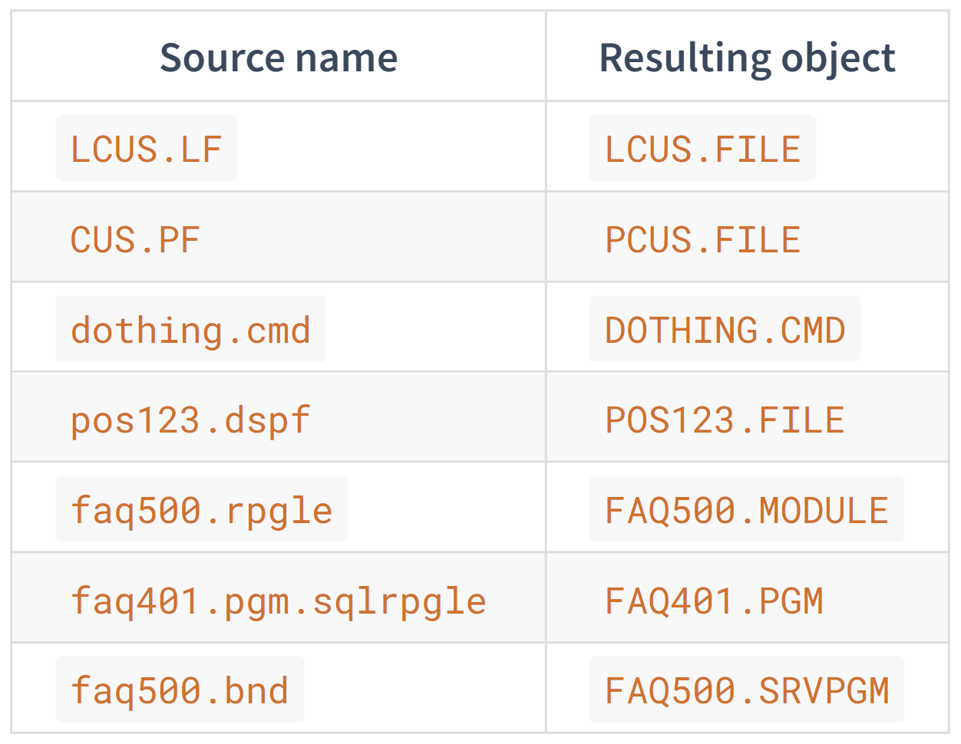
Source Code Rules – Object Names
Base name of source file becomes object name
If source includes .pgm, then it will become a program
If source does not include .pgm, then it will become a module, cmd, dtaara, etc.
Assumes binder source (.bnd/.binder) is a service program

Slide 31
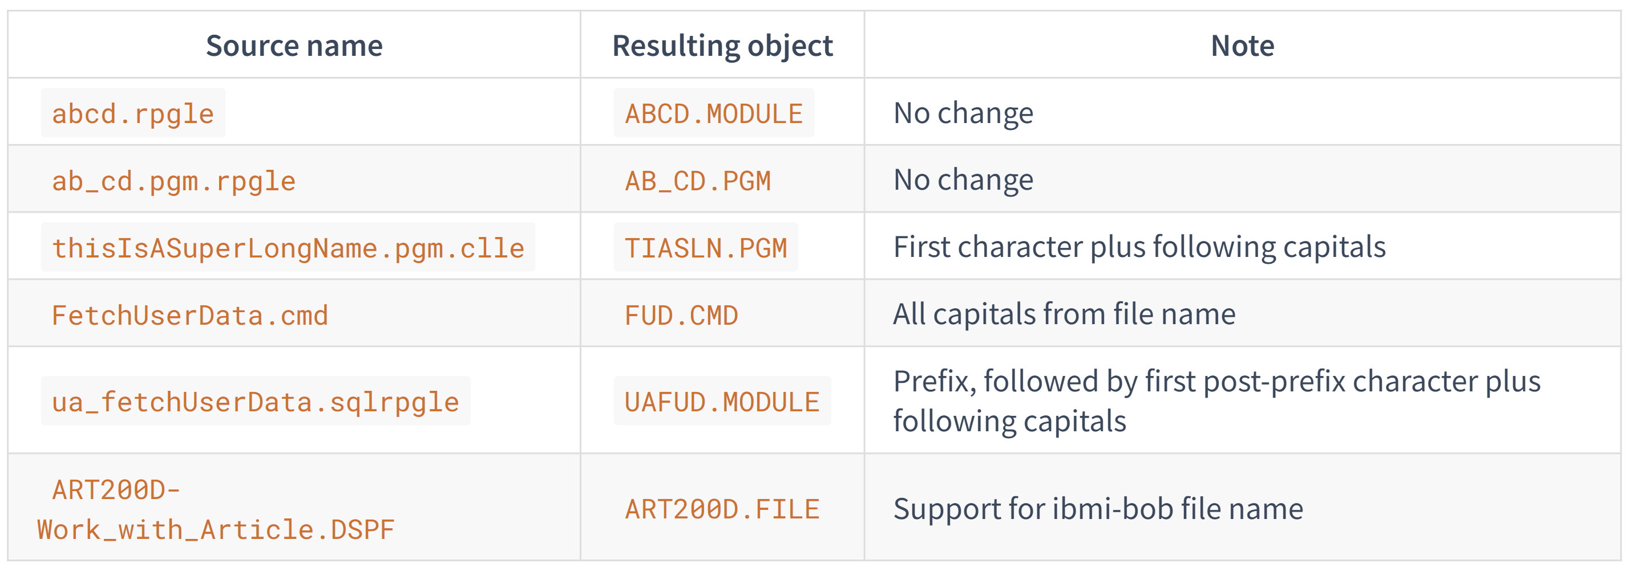
Source Code Rules – Long File Names
Source Orbit will generate a deterministic object name based on the file name

Slide 32

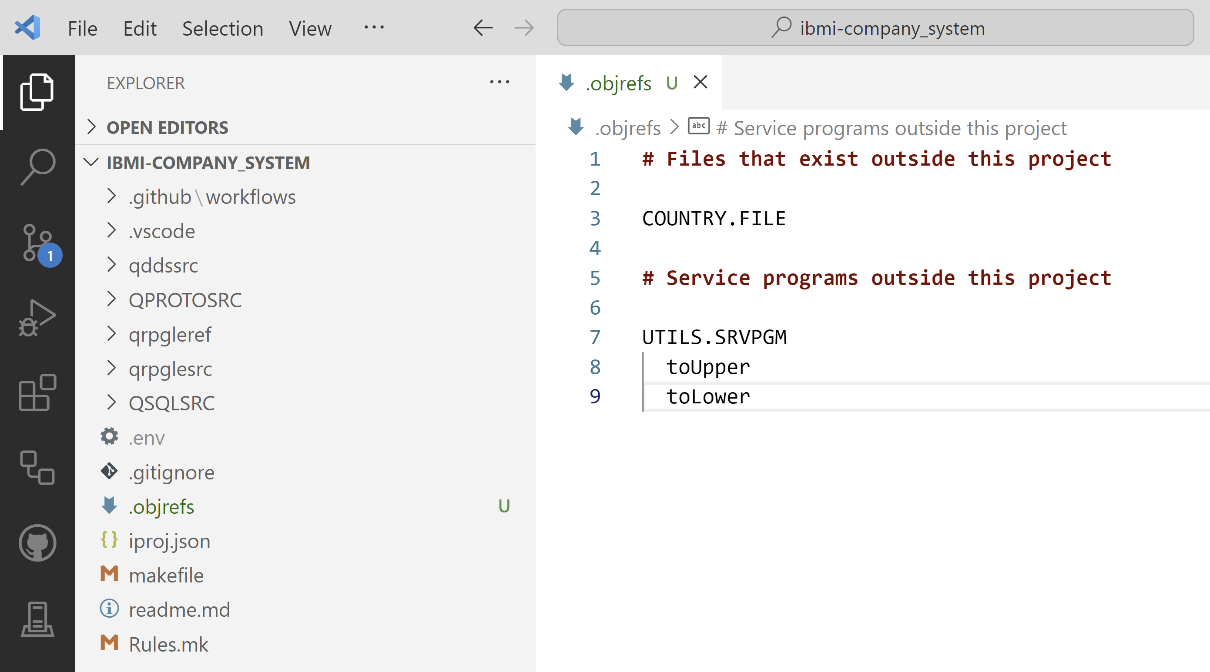
Source Code Rules – Unresolved Objects
Source Orbit will complain about unresolved objects
List objects/source that are in another repository or already exist in a library
For service programs, list exports by indenting after reference
Create file in project root

Slide 33
Practical Use Cases

Slide 34
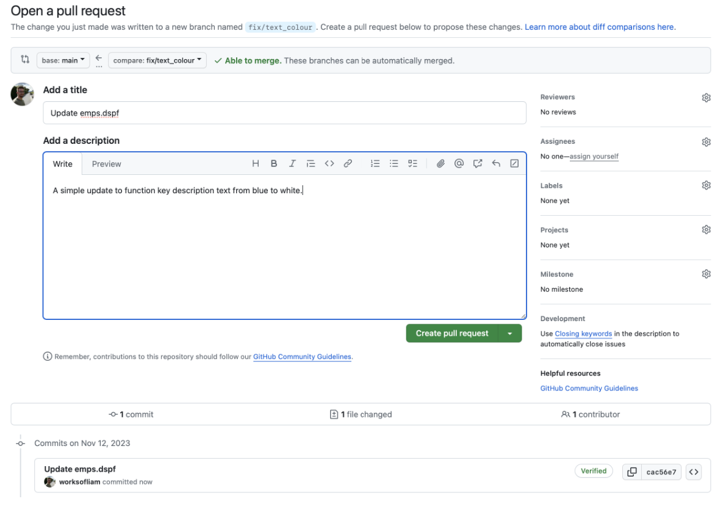
Create New Pull Request…

Slide 35
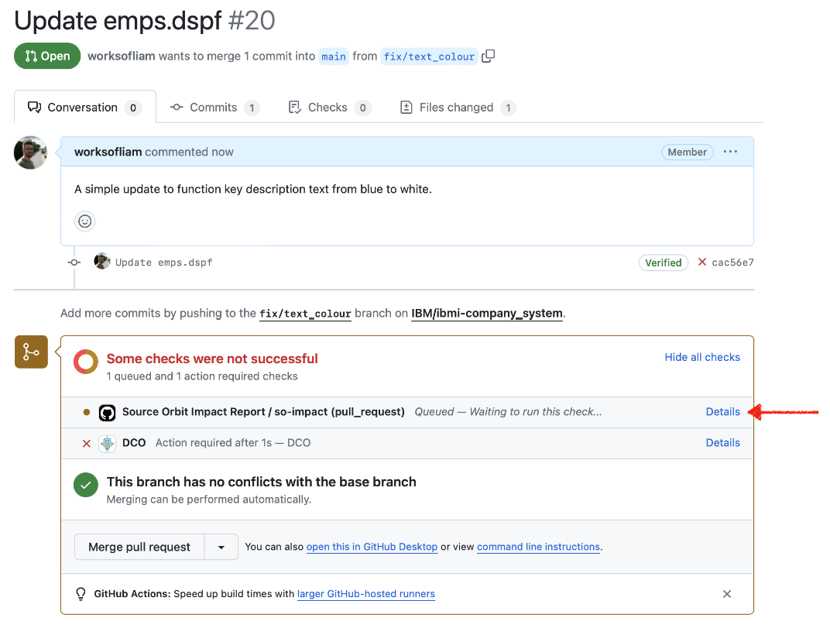
Trigger a Workflow…

Slide 36
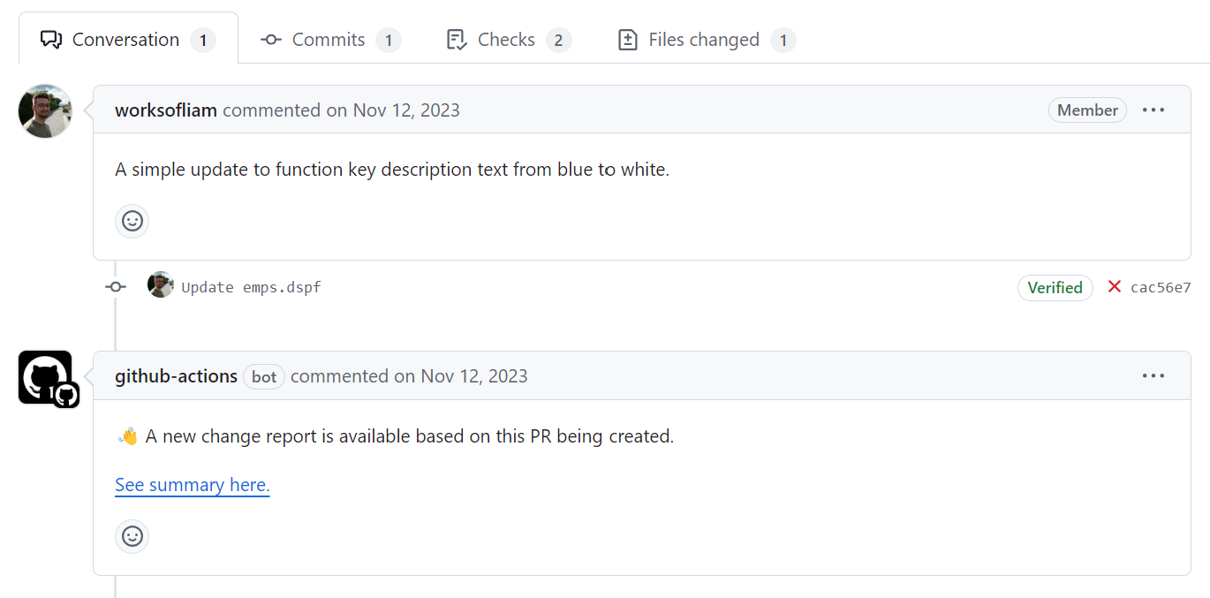
Post a Comment…

Slide 37
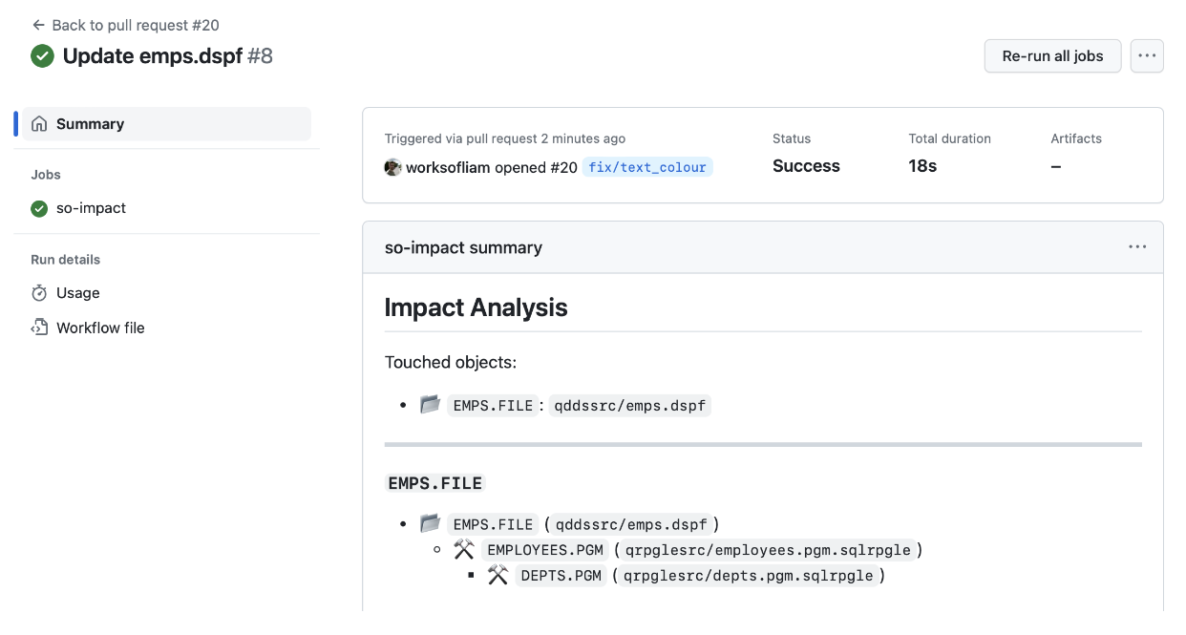
View Impact Analysis….

Slide 38
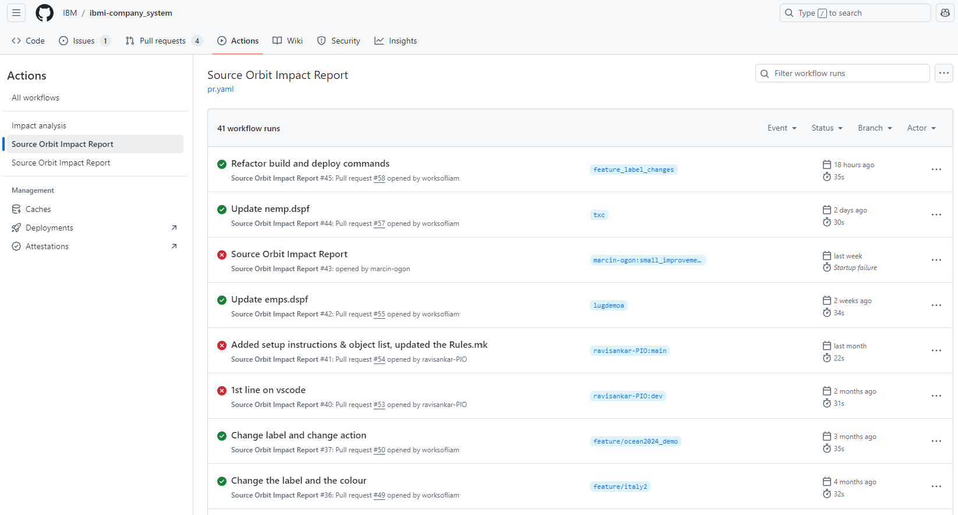
View Build Status…

Slide 39
Demo

Slide 40
Any Questions?

Slide 41
Important Links
ibmi-ci
NPM https://www.npmjs.com/package/@ibm/ibmi-ci
GitHub Repository https://github.com/IBM/ibmi-ci
Source Orbit
NPM https://www.npmjs.com/package/@ibm/sourceorbit
Extension https://marketplace.visualstudio.com/items?itemName=IBM.vscode-sourceorbit
Documentation https://ibm.github.io/sourceorbit/#/
GitHub Repository https://github.com/IBM/sourceorbit
SSH on IBM i
Setup Instructions https://www.seidengroup.com/how-to-configure-and-use-ssh-on-ibm-i/

Slide 42

For More Information
Links You Need | Twitter | #Hashtags
IBM i Home Page: https://www.ibm.com/it-infrastructure/power/os/ibm-i (find link to Forrester Study and updated IBM i Strategy Whitepaper) IBM Strategy Whitepaper: https://www.ibm.com/it-infrastructure/us-en/resources/power/i-strategy-roadmap/ IBM Client Success: https://www.ibm.com/it-infrastructure/us-en/resources/power/ibm-i-customer-stories/ Support Life Cycle: https://www.ibm.com/support/lifecycle/ License Topics: https://www-01.ibm.com/support/docview.wss?uid=nas8N1022087 Fortra IBM i Marketplace Survey https://www.fortra.com/resources/guides/ibm-i-marketplace-survey-results | @IBMSystems @COMMONug @IBMChampions @IBMSystemsISVs @IBMiMag @ITJungleNews @SAPonIBMi @SiDforIBMi | #PowerSystems #IBMi #IBMAIX #POWER9 #LinuxonPower #OpenPOWER #HANAonPower #ITinfrastructure #OpenSource #HybridCloud #BigData

Slide 43

Automating Builds in Git on IBM i - Sanjula Ganepola
Please take the last minute of this session to complete the evaluation. A direct link to the evaluation can be found using the QR code below.

